Slide 1
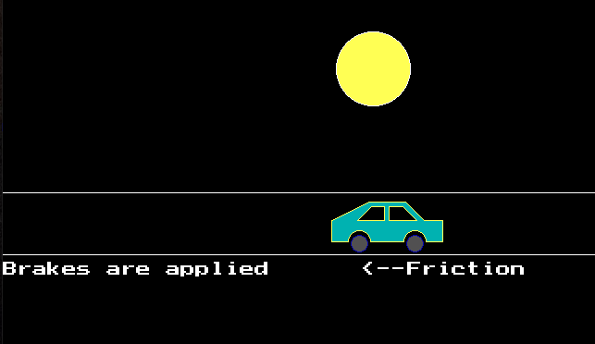
Aim of The Project
To make a stimulation for visualizing stopping of a moving car on the road due to friction.

Slide 2


Resources and requirements
1) Tubro c++ compiler
2) Knowledge of C programming
3) Knowledge of graphics.h header file
Important resources:
→ https://www.geeksforgeeks.org/
→ https://www.wikipedia.org/

Slide 3
Predefined functions used:
1) getmaxx() → getmaxx() function which returns the maximum X coordinate for current graphics mode and driver.
2) getmaxy() → getmaxy() function which returns the maximum Y coordinate for current graphics mode and driver.
3) setcolor() → setcolor() function which is used to set the current drawing color to the new color.
4) setfillstyle() and floodfill() → The header file graphics.h contains setfillstyle() function which sets the current fill pattern and fill color. floodfill() function is used to fill an enclosed area. Current fill pattern and fill color is used to fill the area.
5) delay() → delay function is used to suspend execution of a program for a particular time.

Slide 4
6) rectangle() → rectangle() is used to draw a rectangle. Coordinates of left top and right bottom corner are required to draw the rectangle. left specifies the X-coordinate of top left corner, top specifies the Y-coordinate of top left corner, right specifies the X-coordinate of right bottom corner, bottom specifies the Y-coordinate of right bottom corner.
7) line() → line function is used to draw a line from a point(x1,y1) to point(x2,y2) i.e. (x1,y1) and (x2,y2) are end points of the line.
8) circle() → circle() function which draws a circle with center at (x, y) and given radius.
9) arc() → arc() function which draws an arc with center at (x, y) and given radius. Start-angle is the starting point of angle and end-angle is the ending point of the angle. The value of the angle can vary from 0 to 360 degree.
10)settextstyle() and outtextxy() → settextstyle() sets the text style using font, direction and font size. outtextxy() prints text on window at (x,y).
11) getch() → getch() fucntion is used to hold the output of the program.

Slide 5

Header Files
The header files stdio.h, conio.h, graphics.h files have been included because functions defined in these files are used in the program.

Slide 6
Initialization and closing of graphics function
void main()
{
int gd = DETECT, gm;
int i, maxx, midy;
initgraph(&gd,&gm,"C:\\TURBOC3\\BGI");
maxx = getmaxx();
midy = getmaxy()/2;
.
.
.
getch();
closegraph();
}

Slide 7
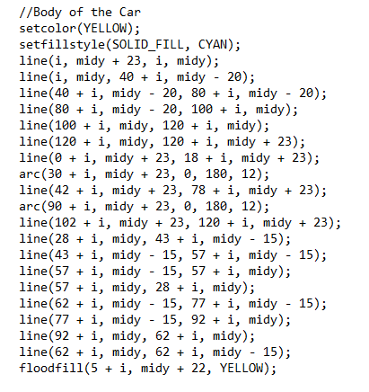

To Draw Car

Slide 8
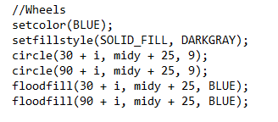


Wheels
Road
Sun

Slide 9
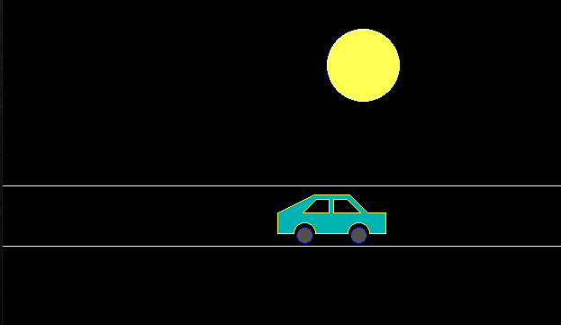

Slide 10
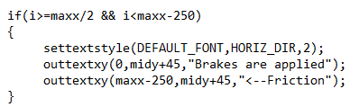
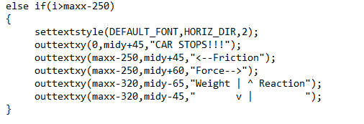
Adding text for Explanation
When Brakes are Applied
Car finally stops

Slide 11
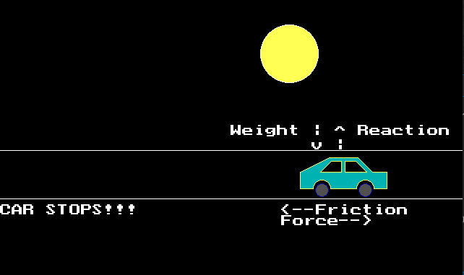
Final Output- explaining the directions of forces

Slide 12
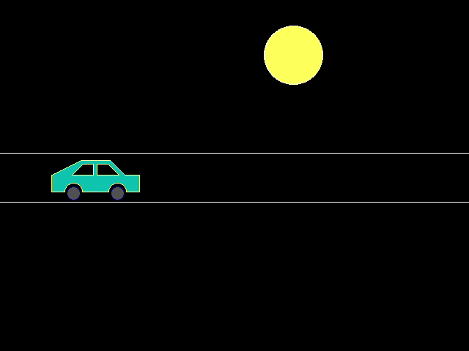
Thank You

